Slide 1
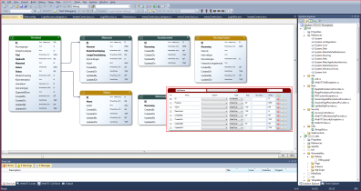
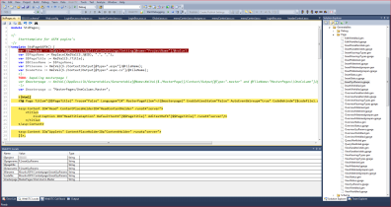
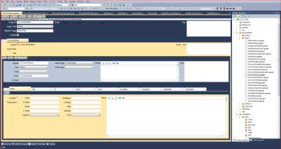
4D vision
WINAK
Developers challenge 2014
4/3/14 – 13/3/14

Slide 2
4D vision – WINAK
4D vision – the company
4D vision is a software developer for companies and organizations for whom standard software is not an ideal solution.
4D vision ensures that decision makers see their own vision completely penetrate the computerization of their business.
4D vision uses a Model Driven development (MDD) approach to build web based data driven applications (WebXTC).

Slide 3
4D vision – WINAK
Required tools to use
Visual Studio 2012/2013 (express)
http://www.visualstudio.com/products/visual-studio-express-vs
SQL server 2012 (express) for application data
http://www.microsoft.com/en-us/download/details.aspx?id=29062
http://technet.microsoft.com/en-US/evalcenter/hh225126
Entity framework for data persisting (code first, …)
http://www.nuget.org/packages/EntityFramework/5.0.0
https://entityframework.codeplex.com/releases/view/87028

Slide 4
4D vision – WINAK
Use a link to Windows Azure Marketplace (WAM) data
https://datamarket.azure.com/account/datasets
Select a (set of) free WAM data source(s) and build a web based application that uses the required tools
 | World Tourism Organization Statistics Database and Yearbook - United Nations World Tourism Organization United Nations
 | WHO Data - World Health Organization United Nations
 | Country Codes oh22information services GmbH
 | Occupational Employment Statistics (2011) Bureau of Labor Statistics, Department of Labor
 | Worldwide Historical Weather Data Weather Trends International

Slide 5
4D vision – WINAK
Example cases
Administration & advice for a real estate investor who wants to invest in a touristic resort
Administration of sponsors and donors for advisory purposes for building hospitals with regard to the historical data of the WHO
Administration & advice with the implantation of schools with regard to the Occupational Employment Statistics data
Combine (free) datasets
Surprise us

Slide 6
4D vision – WINAK
Rules
Teams of maximum 3 persons
Each team needs to subscribe (Jessica)
Final delivery of the solution (scope doc 1A4, *.zip)
Thursday 13/3 8u
(if more than 3 teams) 4D vision selects a top 3
Top 3 presents their solution
13/3@19:30 in max 20 minutes
Voting by the public
Winning team receives a voucher (€50 pp)

Slide 7
4D vision – WINAK
Scoring
Application idea
Use of the required technology
Use of new technology
Html5
Css3
Responsive design
Mobile (phone/tablet)
presentation

